Slide 1
Using MySQL Instead of In-Memory Database

Slide 2
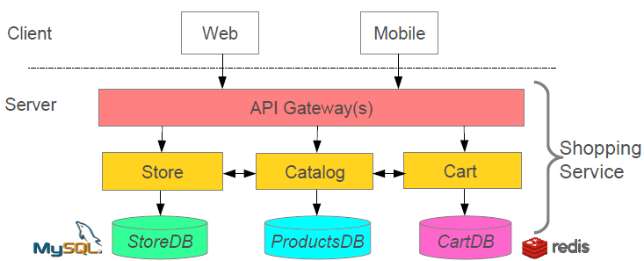

Slide 3
Configure MySQL Database Access Details <dependency> <groupId>mysql</groupId> <artifactId>mysql-connector-java</artifactId> <scope>runtime</scope> </dependency>

